Slide 1
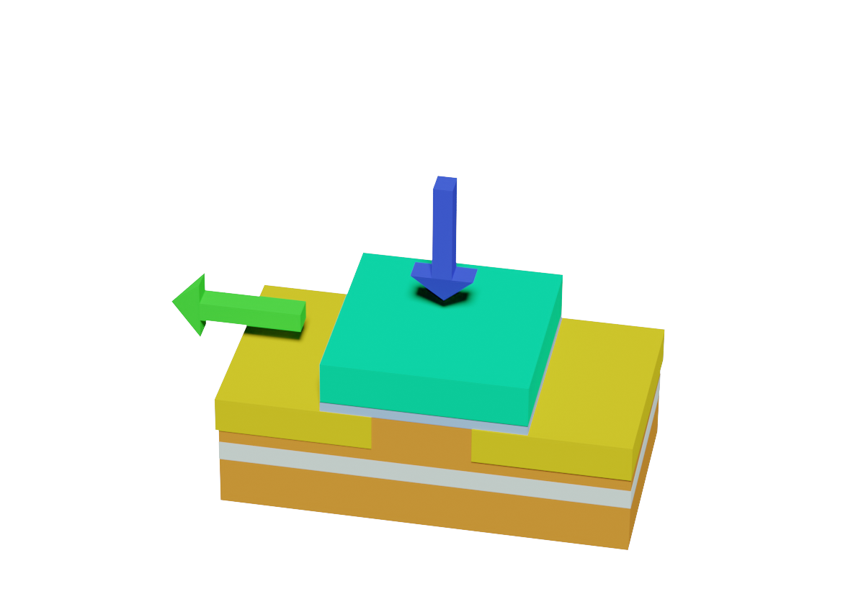
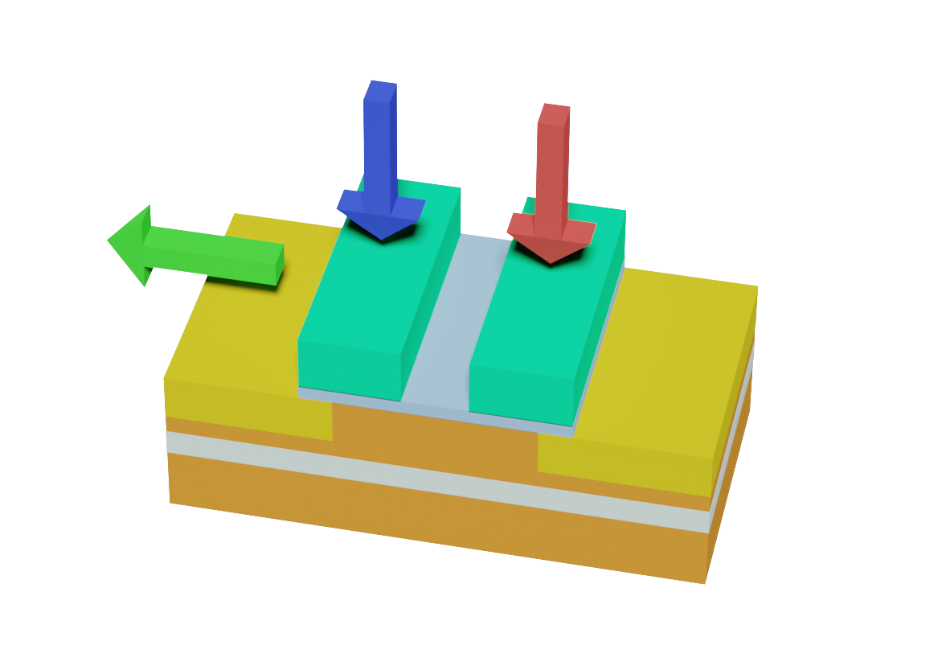
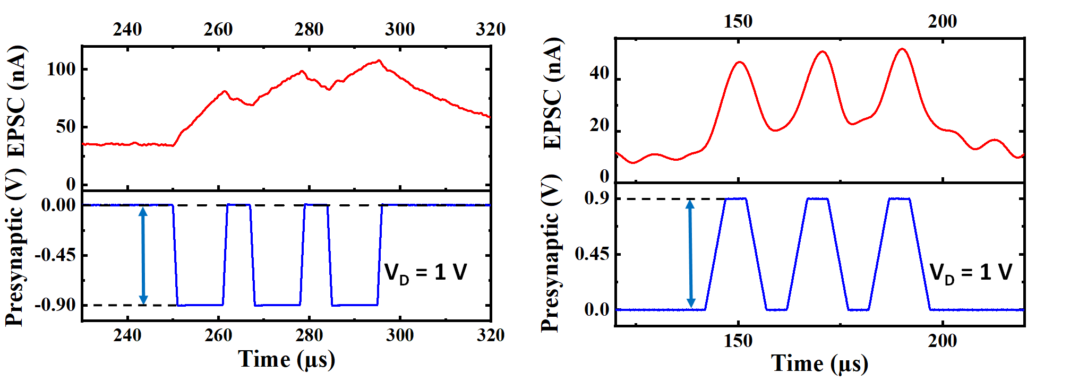
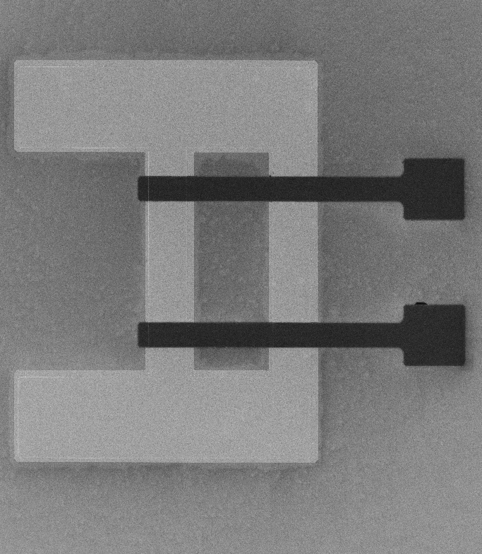
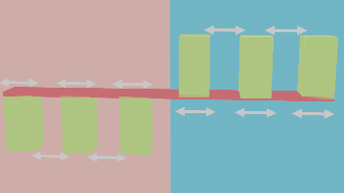
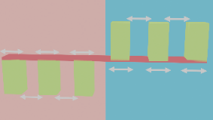
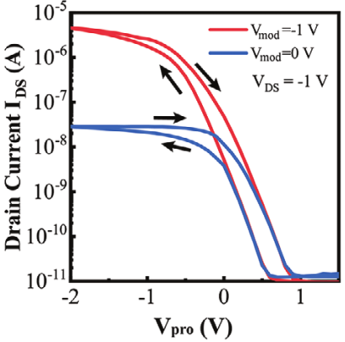
Synapses with Homo/Hetero-Synaptic Plasticity Enabled by Ferroelectric Polarization Modulated Schottky Diodes
Andreas Grenmyr, Jiayuan Zhang, Stefan Wiefels, Detlev Grützmacher, Qing-Tai Zhao
Peter Grünberg Institute (PGI), Forschungszentrum Jülich, 52428 Jülich, Germany
Neuromorpic Computing using CMOS compatible devices and technology promises high integration.
Heterosynaptic properties of the synapses are useful for achieving more conductive states.
For a full neuromorphic system, both synapse arrays and neurons are required.
In this work, we present both synapses and neurons by using Fe-SBFETs on SOI with very simple structures.
Design & Concept
Short-Term Plasticity
In Memory-Logic
Homosynaptic Fe-SBFET
Holes as neurotransmitter
Electrons as neurotransmitter
Pre-Synaptic Neuron
Post-Synaptic Neuron
V_{PRO}
0
0
1
0
0
1
0
0
1
_{EPSC}
NiSi₂
HZO
TiN
0
1
1
0
1
1
0
1
1
Si
SiO₂
NiSi₂
Bulk Si
1
0
1
1
0
1
1
0
1
Three-terminal Fe-SBFET
Holes or electrons as a neurotransmitter for the three-terminal Fe-SBFET.
Heterosynaptic Fe-SBFET
Pre-Synaptic Neuron
Modulatory Neuron
Holes as Neurotransmitter
Electrons as Neurotransmitter
Using the four-terminal Fe-SBFET, the input on the two gates can function as an AND logical gate, with the drain current as the output.
Post-Synaptic Neuron
V_{PRO}
V_{MOD}
_{EPSC}
TiN
HZO
Synapse Array
NiSi₂
Si
SiO₂
NiSi₂
Selected Cell:
(1,1)
(2,1)
BL 1
Bulk Si
(1,1)
(2,1)
WL1
Four-terminal Fe-SBFET
PPF using either holes or electrons as neurotransmitter for the three-terminal Fe-SBFET.
FeFET
(2,1)
(2,2)
G
Scaled 100nm Fe-SBFET
Long-Term Plasticity
(1,2)
(2,2)
G
Holes as neurotransmitter
Electrons as neurotransmitter
BL 2
WL2
-0.5V
0.5µs
0.5µs
+0.3V
0.5µs
0.5µs
-0.3V
SL 1
SL 2
0.5µs
0.5µs
+0.5V
0.5µs
0.5µs
V_{D}= 1.0 V
V_{D}= 1.0V
By having different configurations on the input, certain cells can be selected for highest weight.
TEM-image of a scaled down version of the Fe-SBFET with a gate lenght of 100nm.
LTP/LTD curves for the three-terminal Fe-SBFET using either holes or electrons as a neurotransmitter.
Neuron
V_{MOD} = 0.0 V
V_{MOD} = -1.0 V
V_{DD}
V_{Read}
Transfer Curve
V_{D}= -0.3V
V_{D}= -0.3V
Input
Inverter 1
Inverter 2
I_{Read}
-0.3V
+0.5V
-0.3V
+0.5V
FeFET
1.0µs
1.0µs
1.0µs
1.0µs
Fire
Inverter
1.0µs
1.0µs
1.0µs
1.0µs
V_{D}= -0.1V
LTP/LTD curves for the four-terminal Fe-SBFET with different modulation voltage applied, thereby changing the conductance.
Reset
Integration
Self-Reset
Transfer curve of the three-terminal Fe-SBFET.
Summary
Fire
Single Synapses
Fe-SBFETs with three or four terminals have been fabricated, with excellent synaptic properties. The three-terminal device have ambipolar properties and therefore the synapse have two different neurotransmitters. Meanwhile, the four-terminal device can work as a heterosynaptic device with more conductive states.
If two inverters from the ambipolar Fe-SBFET are connected in series, they can work as an integrate- and-fire neuron.
Synapse Arrays and Neurons
Acknowledgements
This work was partially supported by the Federal Ministry of Education and Research (BMBF, Germany) in the project NEUROTEC (16ME0398K).
By using the properties of Fe-SBFETs, both in memory logic, synapse arrays and integrate-and-fire neurons have been fabricated. This together with the CMOS compatible process for fabricating the Fe-SBFETs makes it highly relevant for the field of neuromorphic computing.
References
[1] F. Xi et al, ACS Applied Materials & Interfaces 2021 13 (27), 32005-32012
Transfer curve of the four-terminal Fe-SBFET.
[2] Xi, F,. et al, Adv. Electron. Mater. 2023, 9, 2201155.
[3] F. Xi et al, ESSCIRC 2022- IEEE, Milan, Italy, 2022, pp. 121-124.

